Slide 1
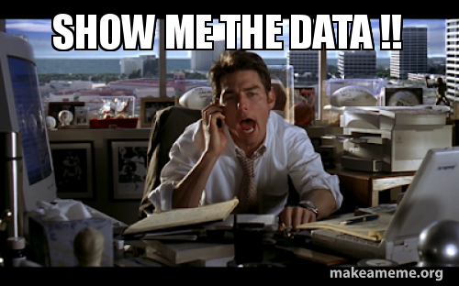
The datasets

Slide 2
The datasets
10+ sets for the entire course (and the exam!)
(And the text book’s data as “gries_data”)
Real-world data from research in the Humanities
Mostly “small”, but hopefully both relevant, diverse and exciting
Many of them collected and analyzed at our university!
They’ll come back around: gradually more complex analyses

Slide 3
Datasets folder
Subfolder per dataset, containing:
Dataset itself as a table (.csv, .xsl, .tsv, .xlsx, ...)
“README”: detailed plain-text description of the dataset’s contents, variables and variable levels, publications based on the data, ...
→ Familiarize yourself with some of the datasets through the homework exercises

Slide 4
Datasets: Overview
Arthur
Chat
Chat_repeated
Correlaciones
Fanfiction
Federalist
Queer
Social
Spelling
BMI
(Gries’s data)
And more

Slide 5
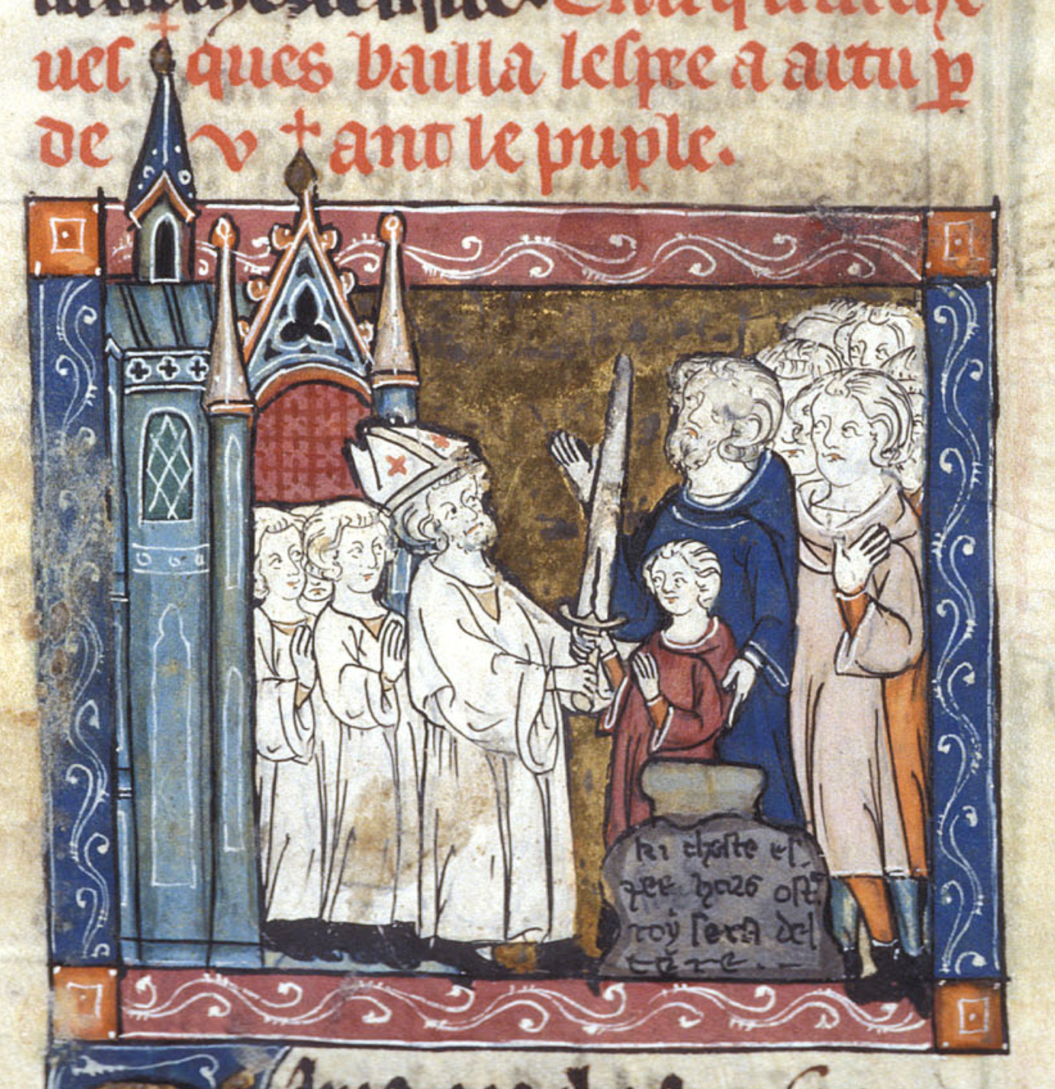
Arthur
Origin: http://www.arthurianfiction.org/
Database of medieval works from Arthurian narratives and the books (manuscripts) in which they survive
Multiple regions/languages from medieval Europe
Detailed information on dimensions of the books:
How large (page and text area)?
How many illustrations, columns, pages?
Paper or parchment?
Date (approximation)?
From which region do they originate?
BL, Additional 10292, f. 100

Slide 6
2. Chat
Sociolinguistic dataset
Collected and analyzed at CLiPS (Hilte, Vandekerckhove, Daelemans)
Summary of Flemish teenagers’ chat conversations (WhatsApp, Facebook):
Socio-demographic info: the teenagers’ “profile”
Gender, educational track
Linguistic info: number of chatspeak features in the text
Emoticons, non-standard Dutch words

Slide 7
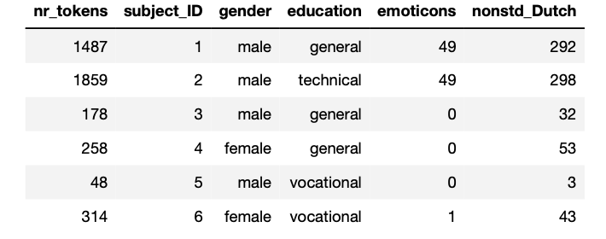
2. Chat

Slide 8
3. Chat_repeated
Sociolinguistic dataset, larger version of “Chat”
Collected and analyzed at CLiPS (Hilte, Vandekerckhove, Daelemans)
Summary of Flemish teenagers’ chat conversations (WhatsApp, Facebook):
Socio-demographic info: the teenagers’ “profile”
Gender, educational track, age category
Linguistic info: number of chatspeak features in the data
Emoticons, non-standard Dutch words
ADDITION: contains “repeated measurements” (= multiple observations for 1 subject - see later)

Slide 9
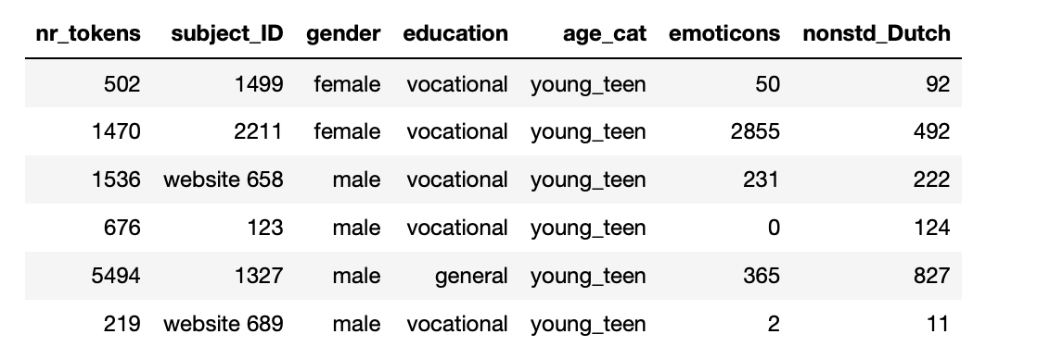
3. Chat_repeated

Slide 10
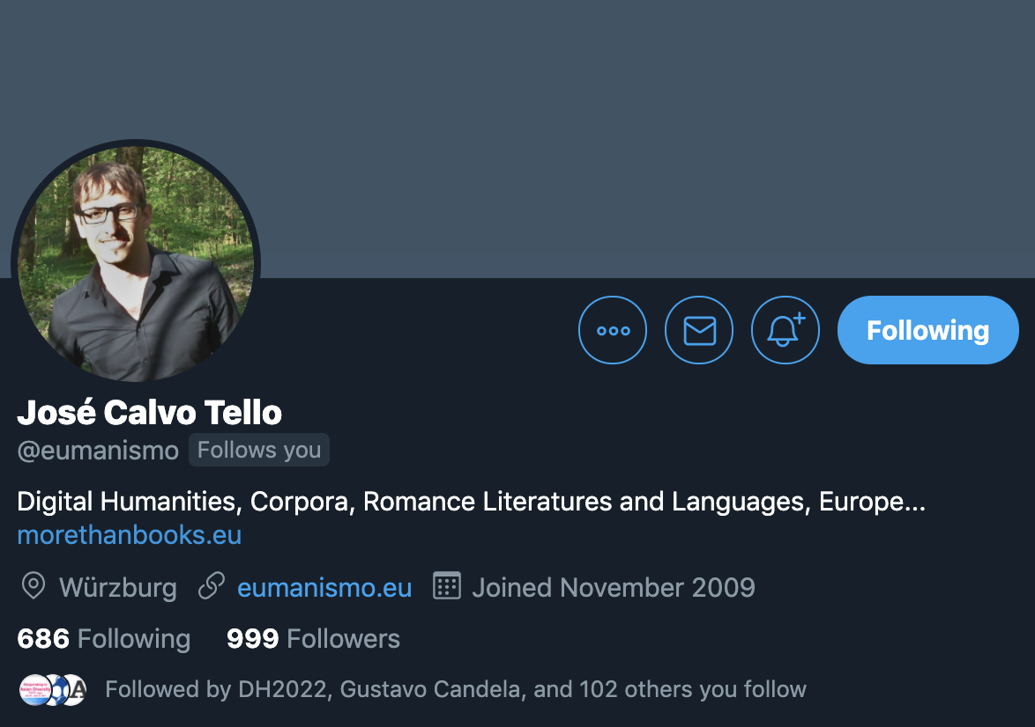
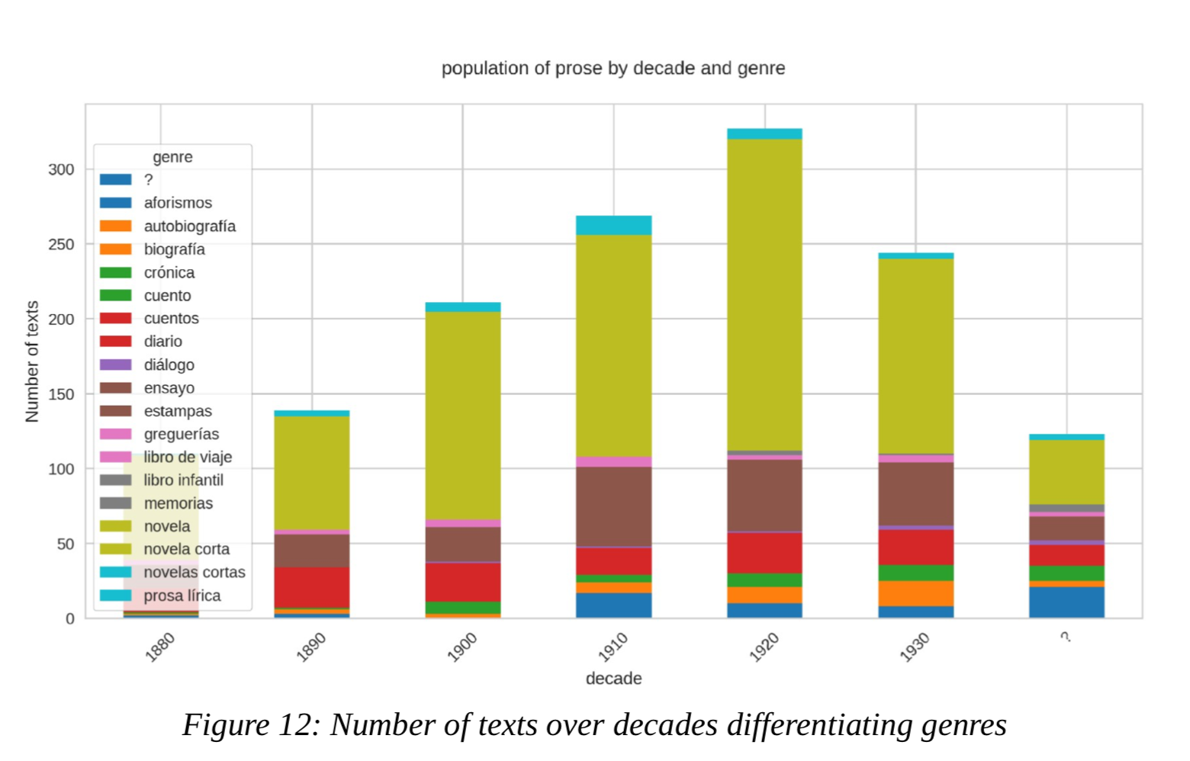
4. Correlaciones
Dataset with metadata on well-known Spanish Literature form the Silver Age
Collected by Dr. José Calvo Tello (morethanbooks.eu) for PhD
Information on authors:
Life span
Gender
How many works/novels published
Etc.
Information on works:
When published?
How long is the story (in days)?
How “canonical” is it?
Etc.
"The Novel in the Spanish Silver Age: A Digital Analysis of Genre through Machine Learning" [2020]

Slide 11
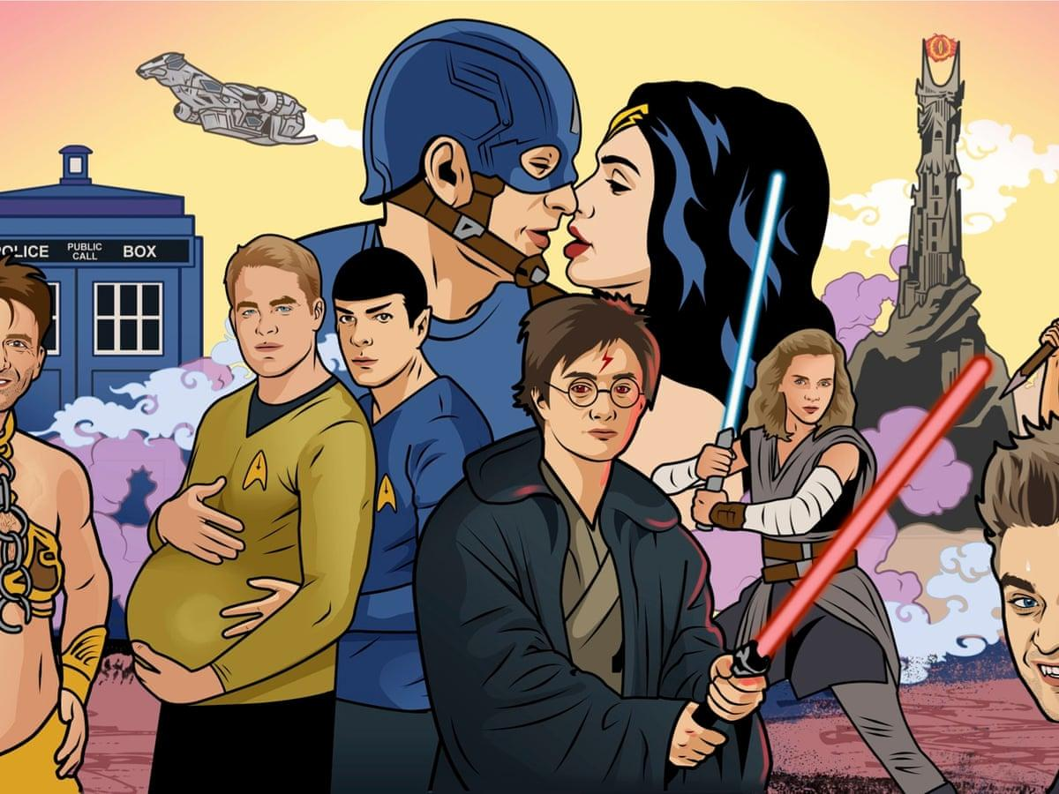
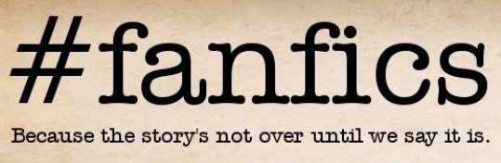
5. Fanfiction
“Fan fiction” or “transformative literature”
Fiction by non-professional authors inspired by cultural “fandoms”, such as J.K. Rowling or Sherlock Holmes
Huge (!) and global phenomenon
Dataset with (user-provided) metadata on “fics”
Intended audience?
When published/finalized?
Which fandom?
Which characters?
How many “likes” and “views”?
(Warning: often “explicit” in nature...)

Slide 12
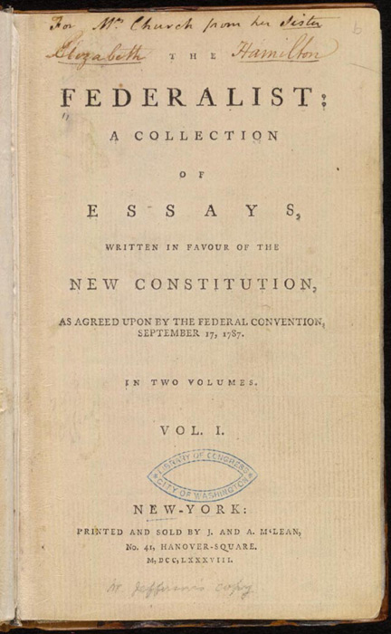
6. Federalist
Federalist papers: collection of papers (ca. 1788)
Promoting the ratification of US constitution
Very famous in US history, but anonymous
All published under pseudonym “Publius”
Famous candidates: Hamilton? Jay? Madison?
“Bag-of-words” table with word frequencies in each essay
Each row = essay
Each column = word
Each cell = absolute frequency of word in text
Statistical authorship attribution

Slide 13
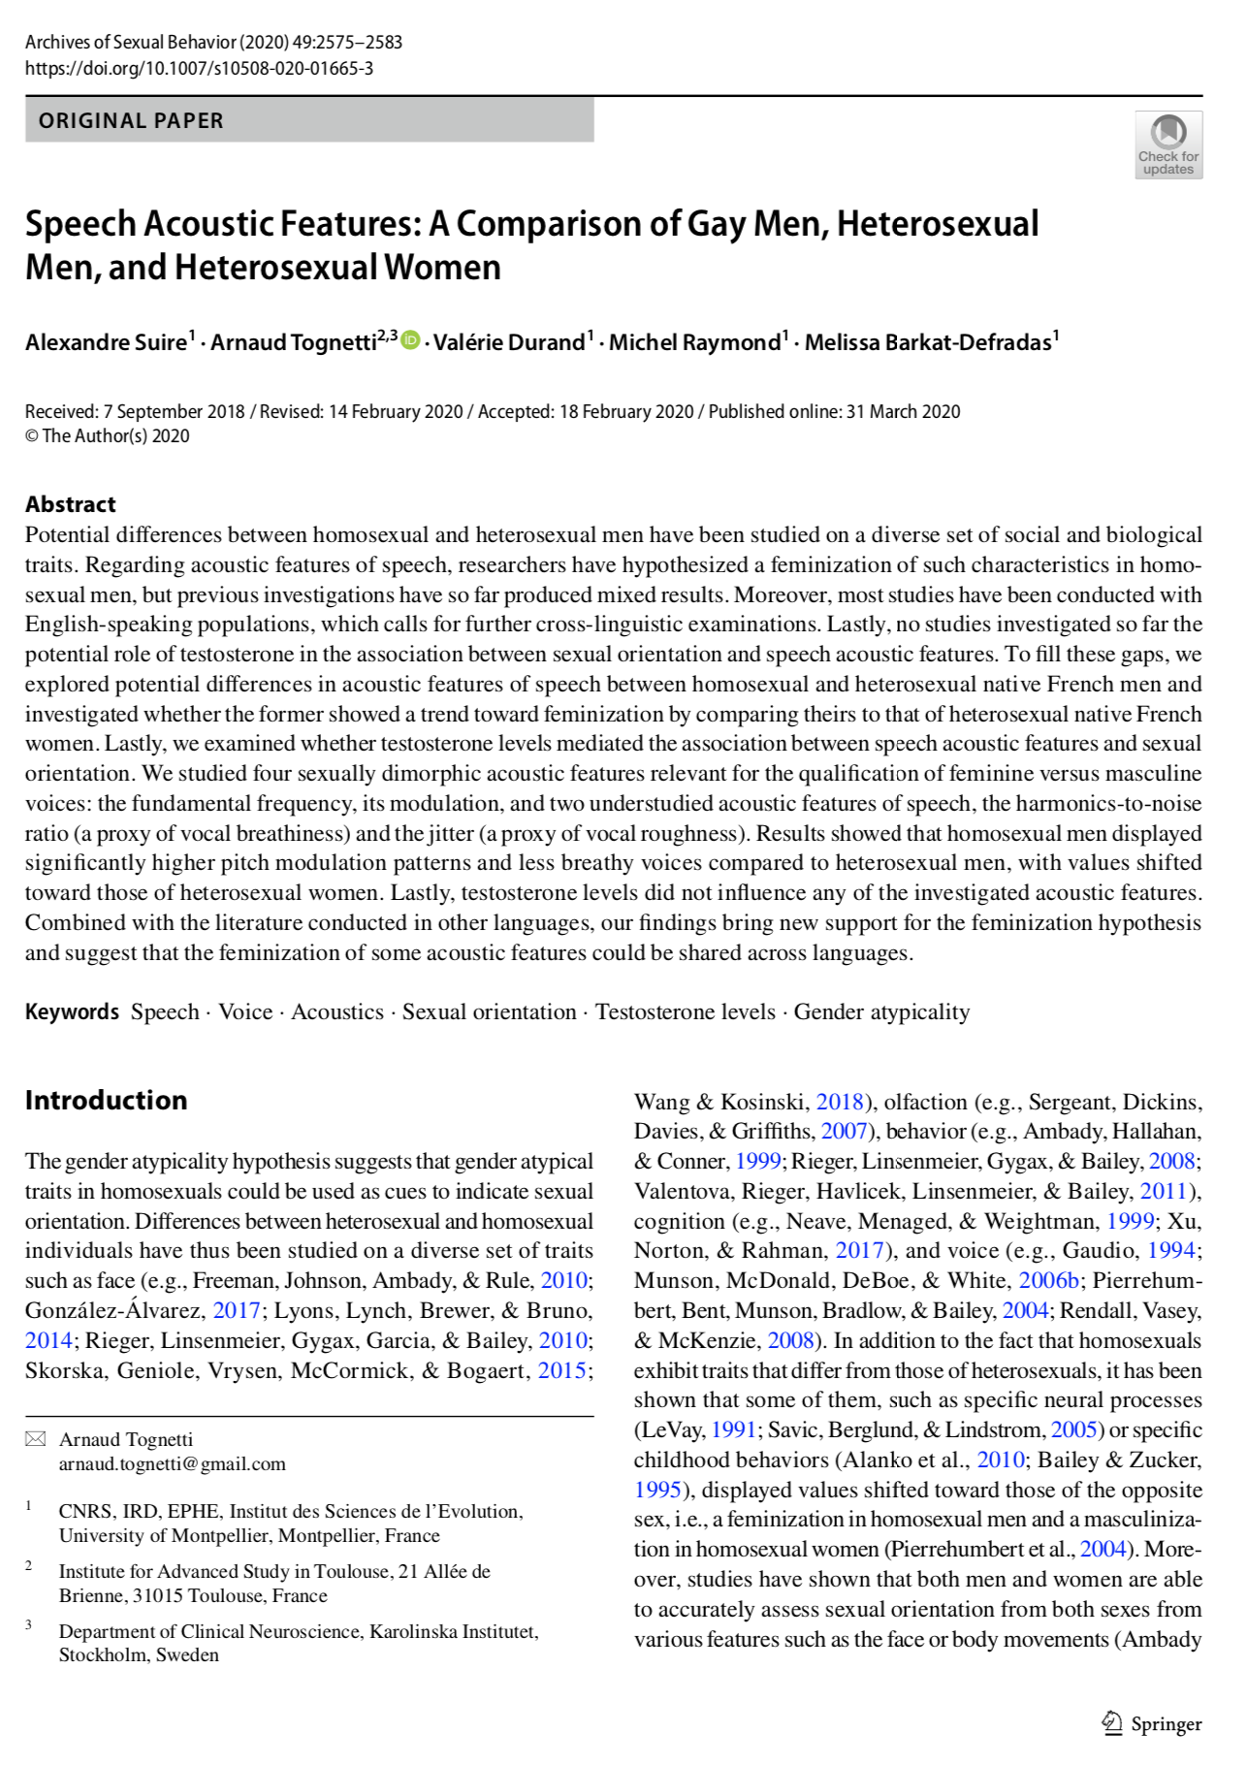
7. Queer
Famous question from sociophonetics (mentioned in Gries)
“Is there a difference in pitch between speech homosexual/heterosexual men?”
Queer studies (umbrella term for sexual and gender minorities who are not heterosexual/cisgender)
Dataset from recent paper (Suire et al. 2020)
Various pitch measurements and sociological variables for set of Spanish speakers

Slide 14
8. Social
Sociological dataset
Collected and analyzed at CLiPS (Hilte, Vandekerckhove, Daelemans)
Flemish teenagers’ socio-demographic and social class profiles
Gender
Educational track in secondary school
Parents’ socio-economic class
Home language

Slide 15
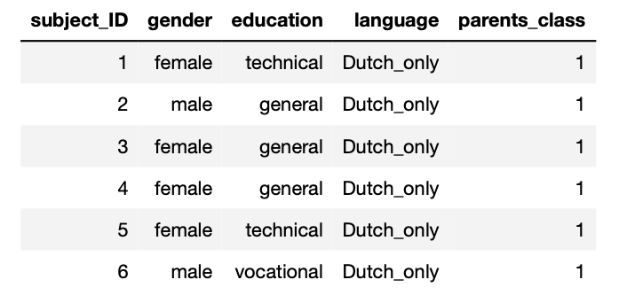
8. Social

Slide 16
9. Spelling
Sociolinguistic and psycholinguistic dataset
Collected and analyzed at CLiPS (Surkyn, Vandekerckhove, Sandra)
Summary of verb spelling errors in Flemish teenagers’ chat conversations (WhatsApp, Facebook):
Socio-demographic info: the teenagers’ “profile”
Gender, age, educational track, grade
Linguistic info: verb spelling errors
Verb lemma, error/no-error
Contains “repeated measurements” (= multiple observations for 1 subject and for 1 lemma - see later)

Slide 17
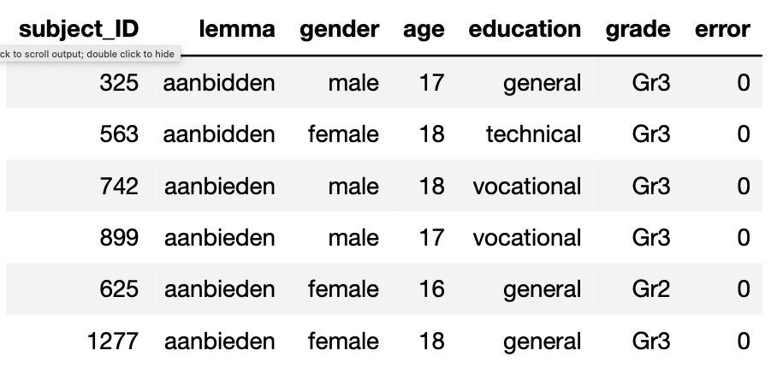
9. Spelling

